Slide 1
MAINTENANCE AND REBUILDS
HOW TO CREATE AUNO TEMPLATE

Slide 2
What is maintenance?
Maintenance is the process of restarting the server based on the application for every week.
Here we do maintenance for both Dev on Saturday and Prod on Sunday.
Firstly we raise a ticket and fill AUNO template for required application with proper subject and timings.
After approval of template we get auto notification as mentioned below:

Slide 3
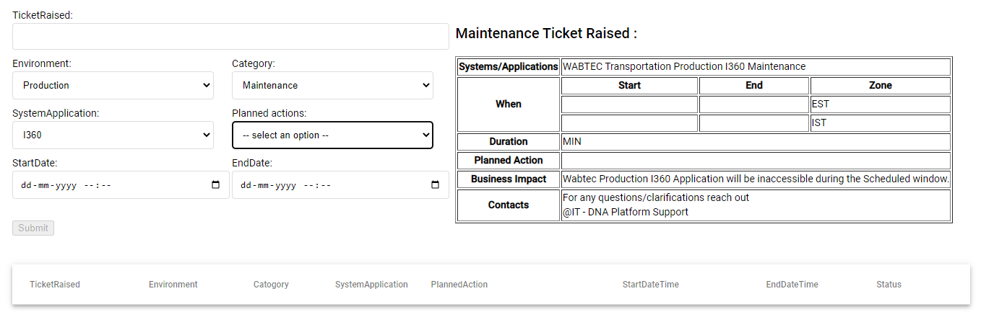

Slide 4
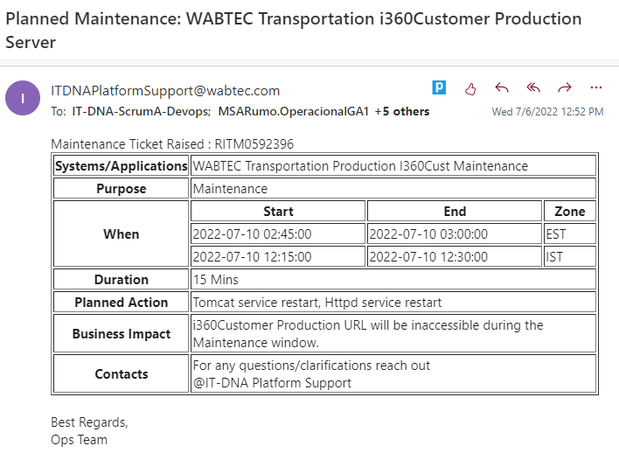

Slide 5
What is rebuild?
Rebuild is used to reorder the server and improves the functionality of the application.
For every application sever there is period of age.
After completion of period, Rebuild is done.
It is same as maintenance, template should be raised and filled all required fields and should be approved.

Slide 6
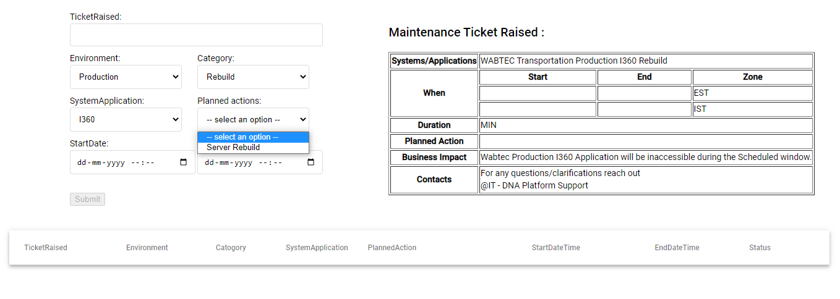

Slide 7
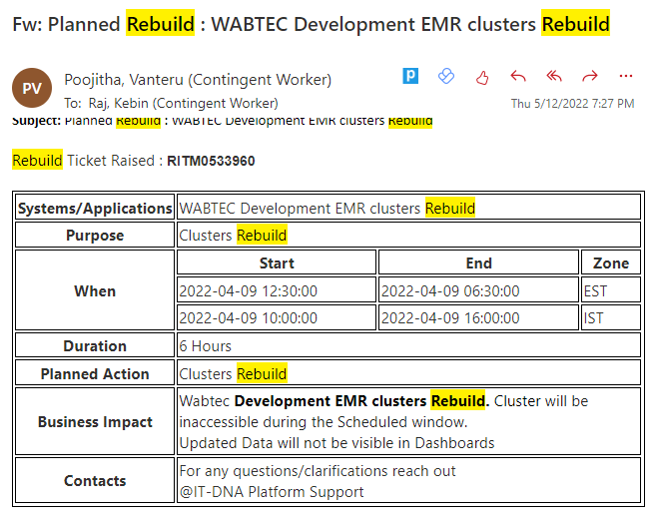

Slide 8


THANKS

